Slide 1
Comic Quest
Space Information Website

Slide 2
Introdution
A space exploration-themed website offering detailed planetary information, daily space photos, Mars rover images, and Near-Earth Asteroid (NEA) news.

Slide 3
Features
01
02
03
04
05
06
Planet Information
User Authentication
Astronomy Pictures
You can describe the topic of the section here
You can describe the topic of the section here
You can describe the topic of the section here
Mars Rover Images
Merchandise Store
Near-Earth Asteroid News
You can describe the topic of the section here
You can describe the topic of the section here
You can describe the topic of the section here

Slide 4
Planet Information
React Three Fiber (for 3D rendering), Axios (for API calls).
Jupiter
Saturn
Uranus
Neptune
Provides detailed information on planets in the solar system, with interactive 3D models of each planet.

Slide 5
User Authentication
Users can sign up, log in, and manage their profiles.
Django Rest Framework (DRF) for authentication, React for front-end forms.

Slide 6
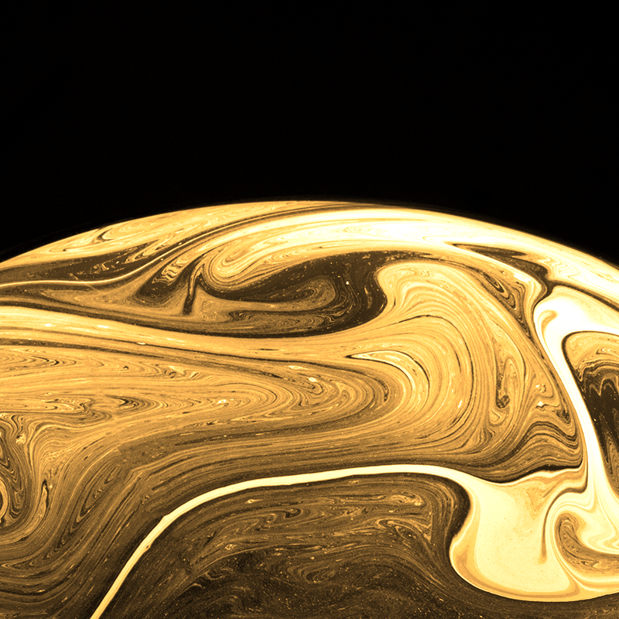
Astronomy Picture
Fetches NASA’s Astronomy Picture of the Day (APOD) and displays it with a short description.
NASA APOD API

Slide 7
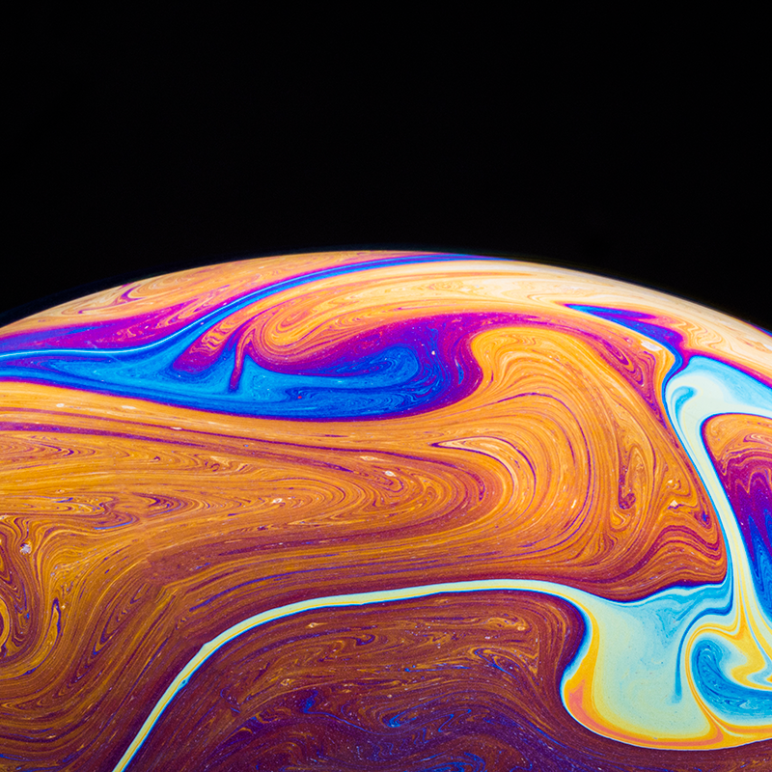
Mars Rover Images
Displays images captured by NASA’s Mars rovers, such as Curiosity and Perseverance.
NASA Mars Rover Photos API

Slide 8
Merchandise Section
Offers space-themed merchandise like t-shirts and books for purchase.
Django for backend e-commerce management, React for front-end shop interface.

Slide 9
Near-Earth Asteroid
News
Displays up-to-date information on Near-Earth Asteroids, including potential close approaches

Slide 10
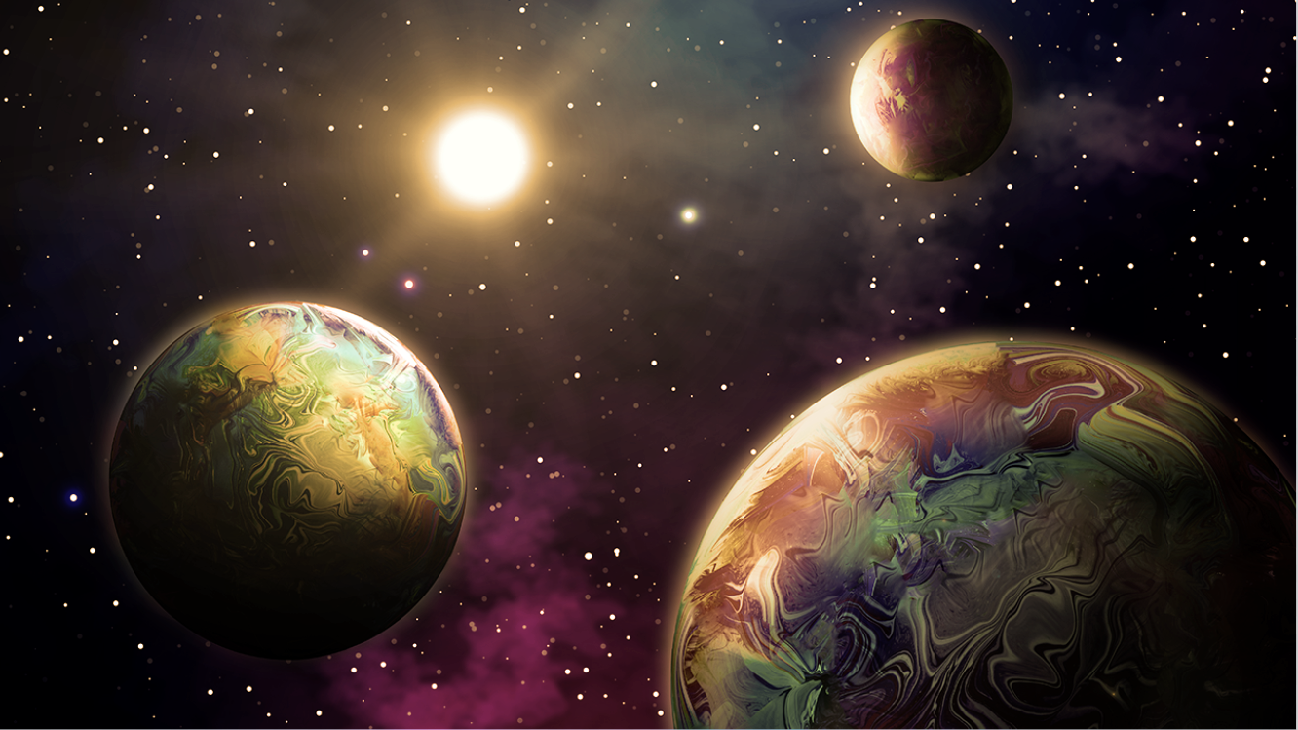
Thanks

